Slide 1

Microsoft Power Platforms
mintesnot

Slide 2
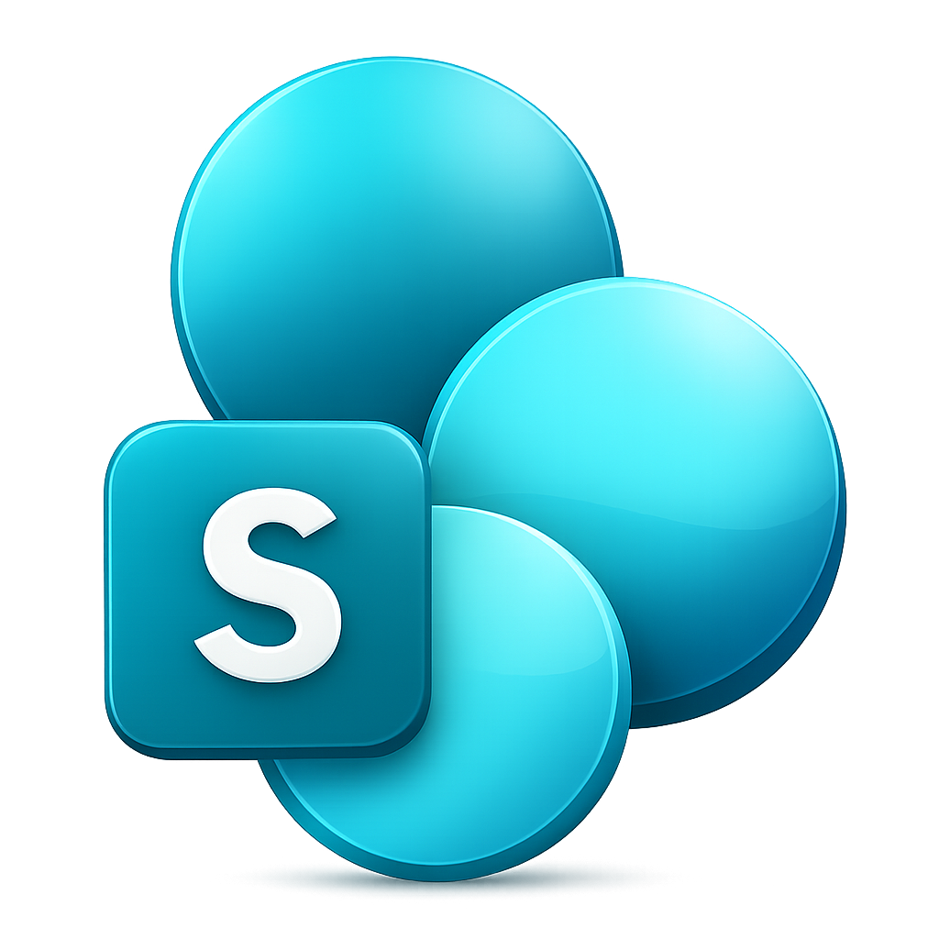
What is SharePoint Site Customization?

Slide 3
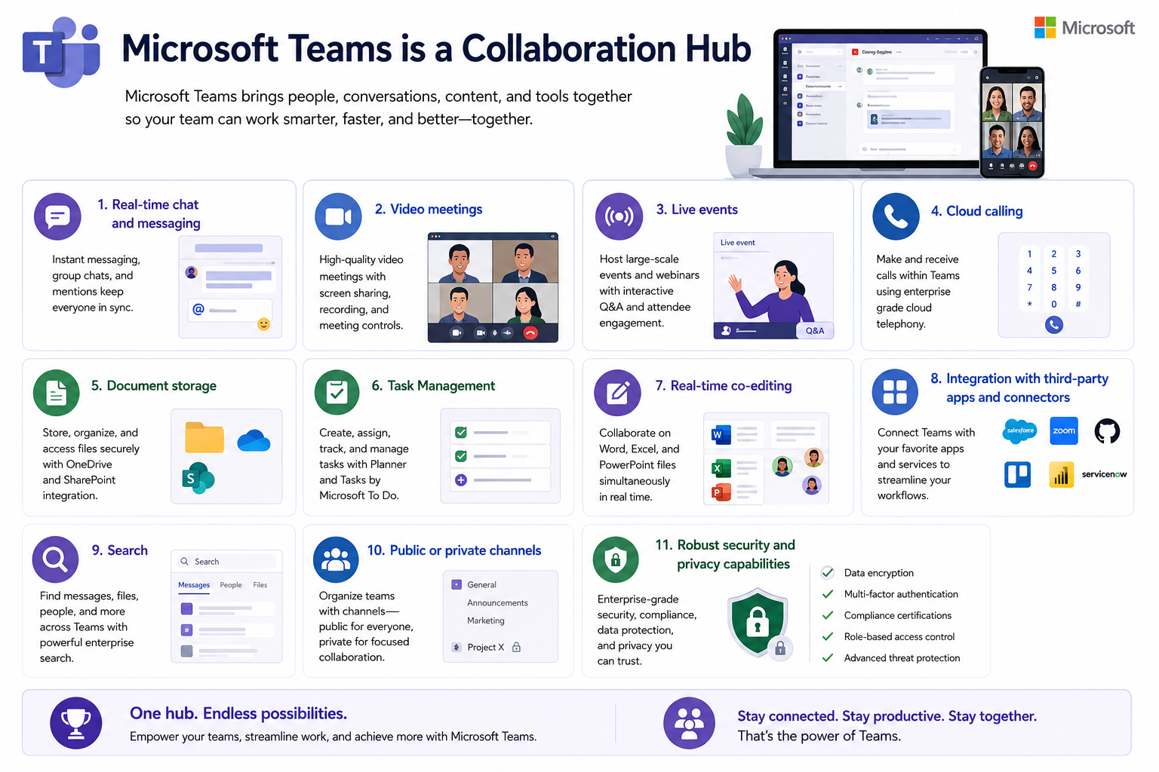

What is Microsoft Power Platform?
Microsoft Teams is a collaboration hub, providing users with key capabilities like:
Real-time chat and messaging
Video meetings
Live events
Cloud calling
Document storage
Task Management
Real-time co-editing
Integration with third-party apps and connectors
Search
Public or private channels
Robust security and privacy capabilities

Slide 4
